Slide 1
Frequent Pattern Growth
(FP Growth)

Slide 2
TransactionID | Items
T1 | {E K M N O Y}
T2 | {D E K N O Y}
T3 | {A E K M}
T4 | {C K M U Y}
T5 | {C E I K O O}
The above-given data is a hypothetical dataset of transactions with each letter representing an item.
Let the minimum support be 3.

Slide 3
Item | Frequency
A | 1
C | 2
D | 1
E | 4
I | 1
k | 5
M | 3
N | 2
O | 3
U | 1
Y | 3
Transaction ID | Items
T1 | {E K M N O Y}
T2 | {D E K N O Y}
T3 | {A E K M}
T4 | {C K M U Y}
T5 | {C E I K O O}

Slide 4
Item | Frequency
A | 1
C | 2
D | 1
E | 4
I | 1
k | 5
M | 3
N | 2
O | 3
U | 1
Y | 3
A Frequent Pattern set (L) is built which will contain all the elements whose frequency is greater than or equal to the minimum support.
As minimum support be 3.
These elements are stored in descending order of their respective frequencies.
After insertion of the relevant items, the set L looks like this:- L= {K:5, E: 4, M: 3, 0:3, Y: 3}

Slide 5
Now for each transaction, the respective Ordered-Item set is built.
A Frequent Pattern set L= {K:5, E: 4, M: 3, 0:3, Y: 3}
Transaction ID | Items | Ordered-Item Set
T1 | E K M N O Y | K E M O Y
T2 | D E K N O Y | K E O Y
T3 | A E K M | K E M
T4 | C K M U Y | K M Y
T5 | C E I K O O | K E O

Slide 6
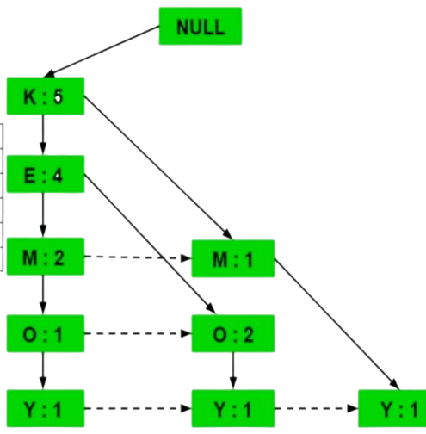
Now all the ordered-Item sets are inserted into a Trie Data Structure
Transaction ID | Items | Ordered-Item Set
T1 | E K M N O Y | K E M O Y
T2 | D E K N O Y | K E O Y
T3 | A E K M | K E M
T4 | C K M U Y | K M Y
T5 | C E I K O O | K E O

Slide 7
Now all the ordered-Item sets are inserted into a Trie Data Structure
Inserting the set {K E M O Y}
Inserting the set {K E O Y}
Inserting the set {K E M}
Inserting the set {K M Y}
Inserting the set {K E O}

Slide 8
Now, for each item, the Conditional Pattern Base is computed which is path labels of all the paths which lead to any node of the given item in the frequent-pattern tree.
Items | Conditional Pattern Base
Y | {{K,E,M,O : 1}, {K,E,O : 1}, {K,M : 1}}
O | {{K,E,M : 1}, {K,E : 2}}
M | {{K,E : 2}, (K: 1))
E | {K:4}
K

Slide 9
Now for each item the Conditional Frequent Pattern Tree is built. It is done by taking the set of elements which is common in all the paths in the Conditional Pattern Base of that item and calculating it’s support count by summing the support counts of all the paths in the Conditional Pattern Base.
Items | Conditional Pattern Base | Conditional Frequent Pattern Tree
Y | {{K,E,M,O : 1}, {K,E,O : 1}, {K,M : 1}} | {K:3}
O | {{K,E,M : 1}, {K,E : 2}} | {K, E:3}
M | {{K,E : 2}, (K: 1)) | {K:3}
E | {K:4} | {K:4}
K

Slide 10
From the Conditional Frequent Pattern tree, the Frequent Pattern rules are generated by pairing the items of the Conditional Frequent Pattern Tree set to the corresponding to the item as given in the below table.
Items | Conditional Pattern Base | Conditional Frequent Pattern Tree
Y | {{K,E,M,O : 1}, {K,E,O : 1}, {K,M : 1}} | {K:3}
O | {{K,E,M : 1}, {K,E : 2}} | {K, E:3}
M | {{K,E : 2}, (K: 1)) | {K:3}
E | {K:4} | {K:4}
K

Slide 11
From the Conditional Frequent Pattern tree, the Frequent Pattern rules are generated by pairing the items of the Conditional Frequent Pattern Tree set to the corresponding to the item as given in the below table.
Items | Conditional Frequent Pattern Tree
Y | {K, Y : 3}
O | {<K, O : 3>, <E, O : 3>, <E, K, O : 3>}
M | {<K, M : 3>}
E | {<E, K : 3>}
K

Slide 12
Thank You

